Slide 1
Quadruped Robot for Agricultural Research
Team: Austin Neff, Kevin Nelson, Jordan Raver, Ben Seisser, Sam Spencer, Yang Yang
Team Advisors: Shad Roundy, Kam Leang

Slide 2
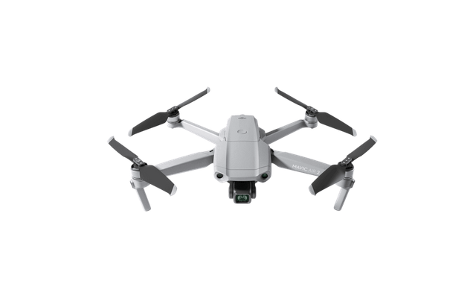
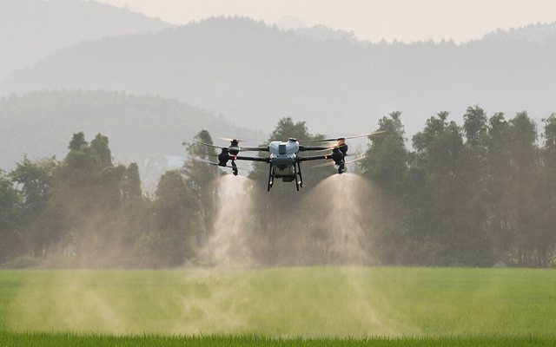
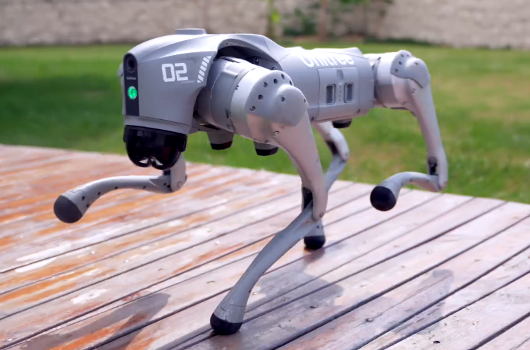
Project Background
In agriculture, autonomous quadcopters are the go-to solution for field surveying
However, they cannot land or modify the terrain, limiting their usefulness
An affordable quadruped could fill in these gaps
Notes:
In agriculture, autonomous quadcopters are the go-to solution for field surveying
However, these quadcopters are limited in what they can measure or modify due to their inability to land or dig
Consequently, a land vehicle is needed to fill in these gaps
Tracked vehicles cannot maneuver over and around sensitive crops without damaging them, so a quadruped is needed
Current quadruped options are some combination of expensive and locked down, so we need an alternative

Slide 3
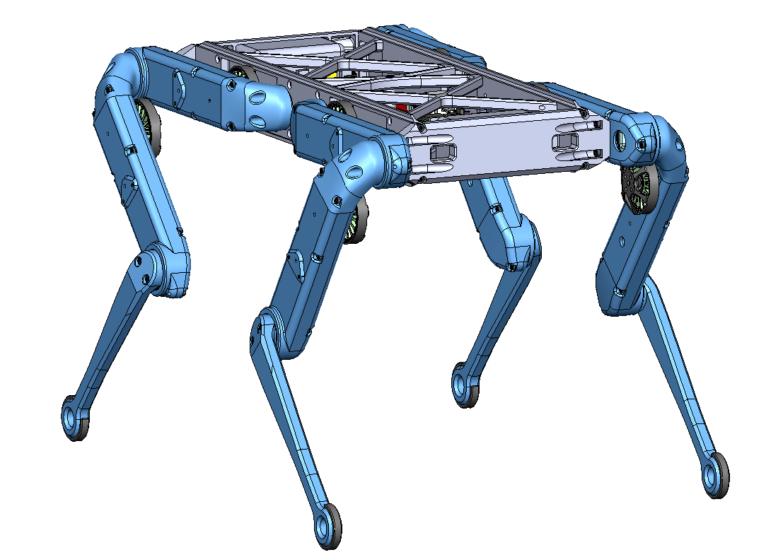
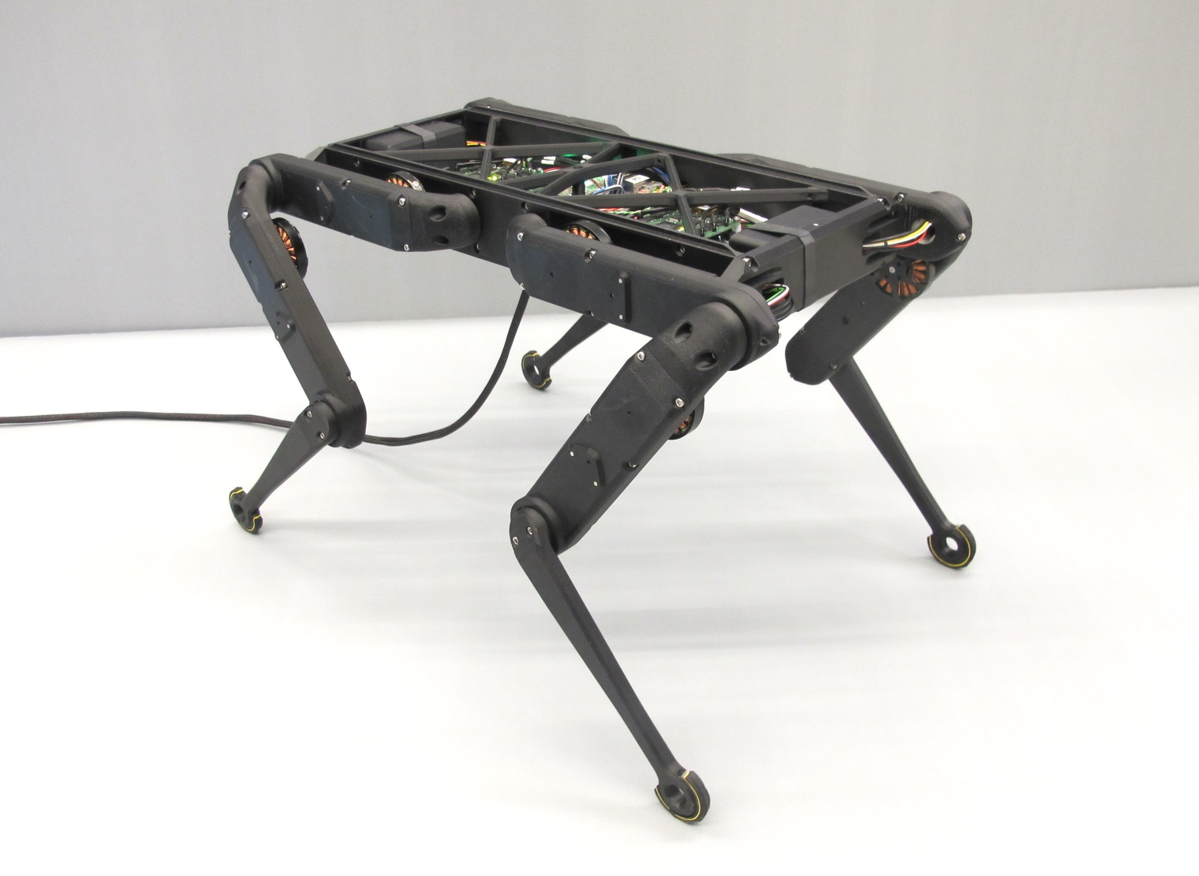
Project Objective
The objective of the project is to construct a quadruped robot. The Open Dynamic Robot Initiative will be used as guidance. The robot is intended as a cheaper and more open alternative for robot smart agriculture than what is currently available in professors Roundy and Leang’s laboratories.

Slide 4
Scope
Must be part of scope | Optional Scope | Not included in Scope
Runs on ROS 2 Use ROS 2 Humble Autonomous; no tether On-board Power System that can run for minimum 30 minutes Can navigate to four points in a field. Modify design to enclose electronics–weathertight Easily storable, carryable (handles, box) Utah red colors | Fully assembled by end of first semester (CF-PLA) Rebuild chassis with stronger materials during second semester (fiberglass infused ABS) | Additional actuators Additional sensors Efficient walking Large Deviations from Open Dynamic Robot Initiative Manipulators Radio beacon triangulation 12 degree of freedom

Slide 5
User Needs
How User Needs Were Determined:
We conducted interviews with Cody and John, asking a variety of questions to determine what they needed and what they would like to see from a quadruped robot.
Interviewees:
John Sanchez
Agricultural researcher at Utah State University.
Has a mechanical engineering PhD and has a history of working on a farm.
Provided a perspective of an advanced user who has a good understanding of the functionality of the robot.
Cody Zesiger
Biology professor of a USU extension.
Works as an intermediary between the agricultural industry and the associated research department.
His background is in horticulture.
His work would often involved understanding the needs of the agricultural industry,

Slide 6
User Needs
Primary Needs:
Replace agricultural laborers
Crop monitoring
Augering (for soil samples)
Weed destruction
Harvesting
Interface with systems in the field
Ex. opening and closing valves for irrigation management
Survive extreme situations including flood waters, snow, many objects, etc.
Navigate uneven and/or muddy terrain and avoid obstacles
Technical Needs:
Cost effective enough to justify replacing the labor
Parts can and should be exchanged/replaced based on needs
Sufficient battery life
Able to accurately determine location

Slide 7
Design Metrics
Metric | Units
Cost of the robot | <$6,000
Robustness and strength of the robot chassis materials (load) | 1.5 times total weight (lbs)
Robot runtime while all motors are moving | 30 minutes
Response Time | 200 ms total
Wireless Delivery | 1000 ft
Accuracy of inertial measurement | 0.1 mgs
Notes:
Include your metrics table from Assignment 02 once complete in 1 slide.
Include a column for items that are in scope, stretch goals, and tasks out of scope.
Each design review, you should highlight any changes to the metrics that have occurred since your last meeting.
Touch on any metrics that your design has met or are in process since your last design review.

Slide 8
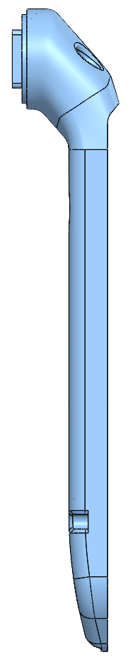
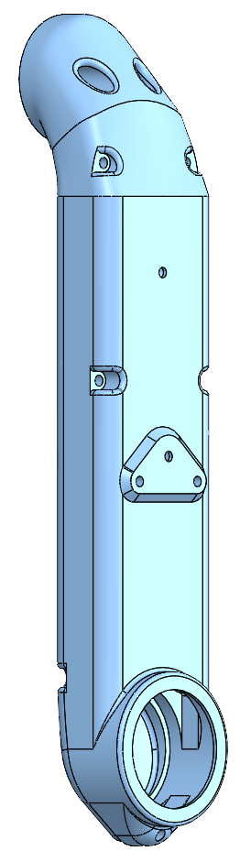
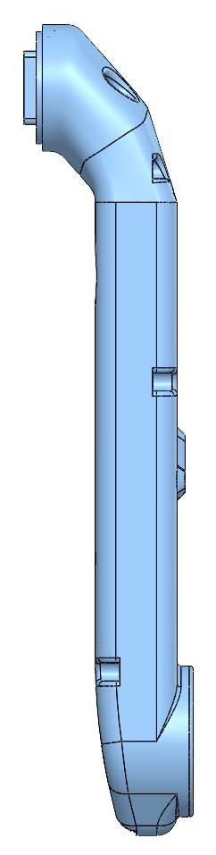
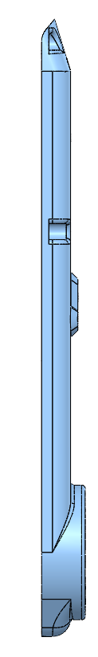
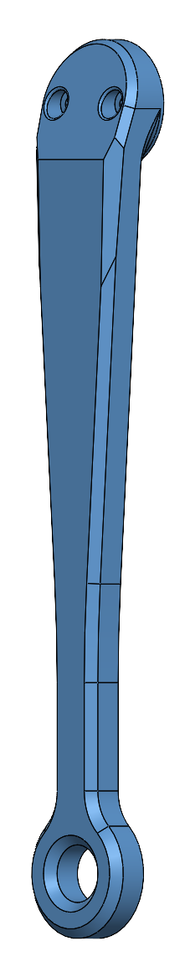
Design Concept (Legs)
The first major design change that we went with was for the legs.
Original Pros and Cons:
Pros:
original model so no need to change any code to accommodate the weight difference.
Cons:
original printing method would result in lots of waste in the form of supports.
outer surfaces are not smooth

Slide 9
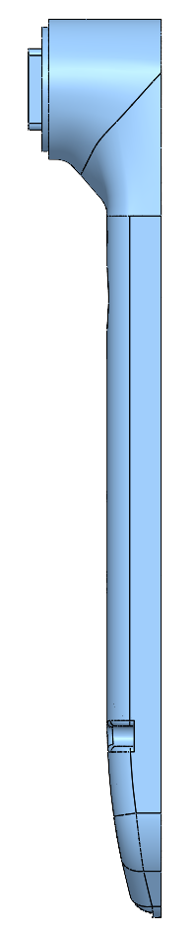
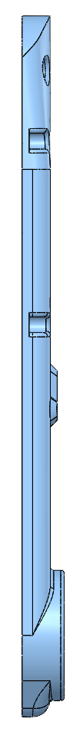
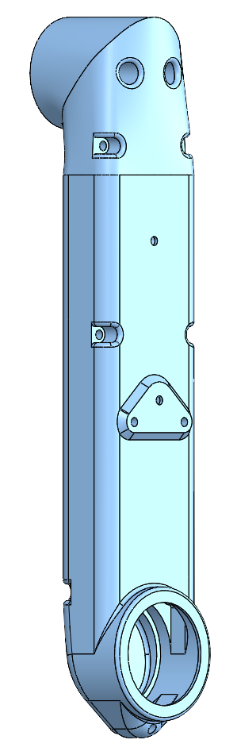
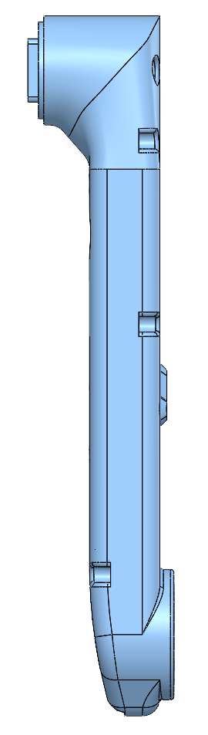
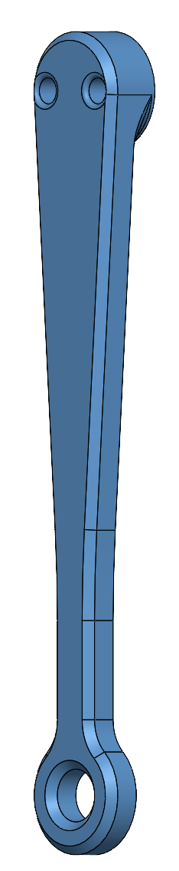
Design Concept (Legs)
Redesign Pros and Cons:
Pros:
complete flat surfaces between the shell and cover.
less supports.
smoother outer surface
Cons:
possible changes in the code might be needed

Slide 10
Engineering Design - 3D Printing
Main Goal:
Make Printing and Assembly Easier
Flat surface between shell and cover
use 3D printers surface to ensure flat surface
More space at joint connections where wires have to feed through holes
Smoother outer surface (cosmetic)
Less supports needed -> Less overall plastic needed for the printed parts
All large body pieces broken in two to be able to print on Bambu printers in senior design lab
All body parts able to be printed flat on sides rather than being printed straight up
Nicer outer finish
Dovetail connections allows less screws to be used.

Slide 11
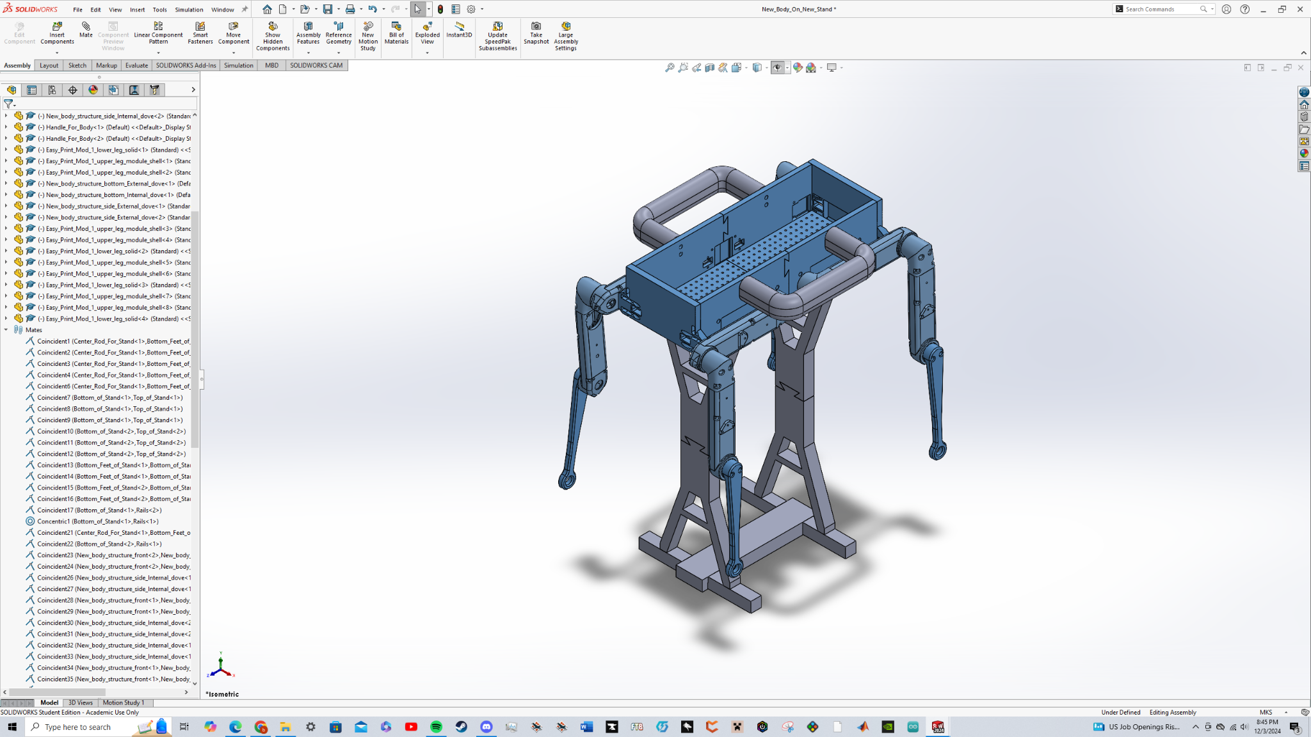
Design Concept (Body)
The second major design change that we went with was for the body
Changes made:
Side walls were broken into two and connected via dove tail
All sides were doubled in height
Original top and bottom frame were discarded
New two piece bottom, also connected via dove tail, was made with numerous connection points
Area for handles to be connected
Notes:
This was done to accommodate the possible introduction of batteries and to accommodate the off the shelf electronics. The new electronics being used are lower in price but also bigger in size.

Slide 12
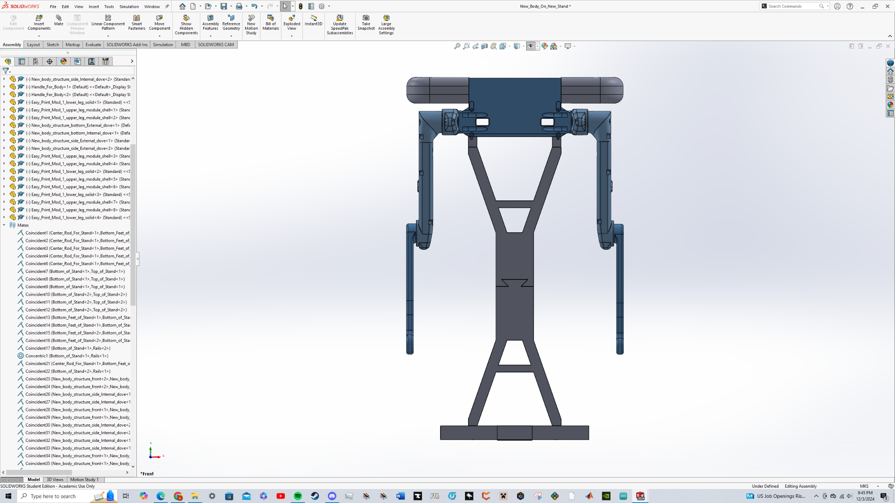
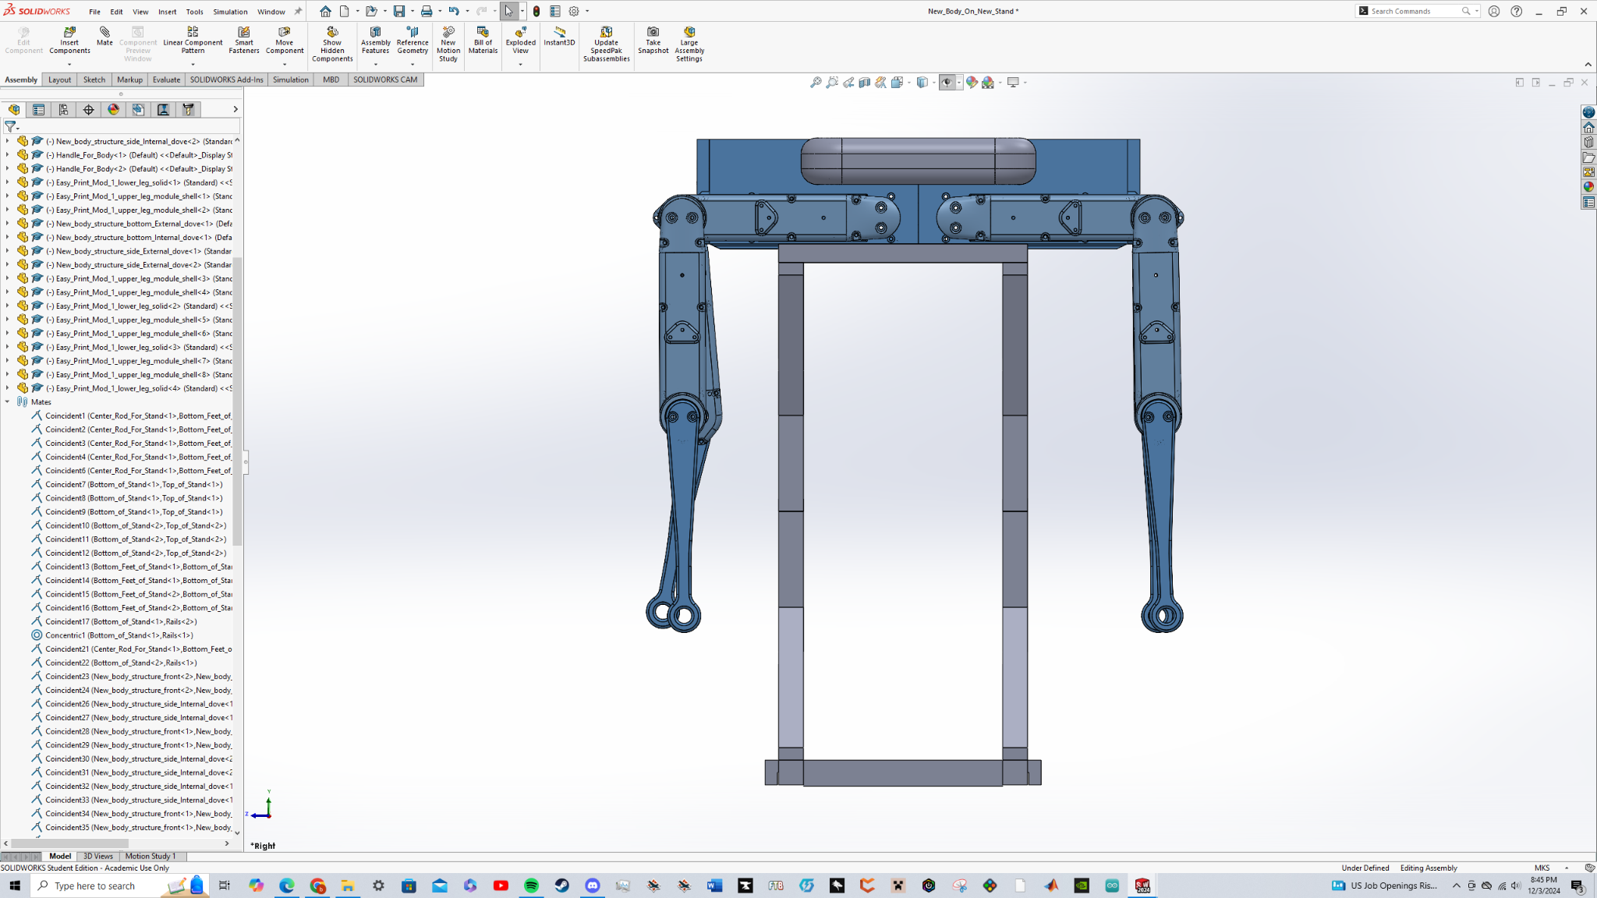
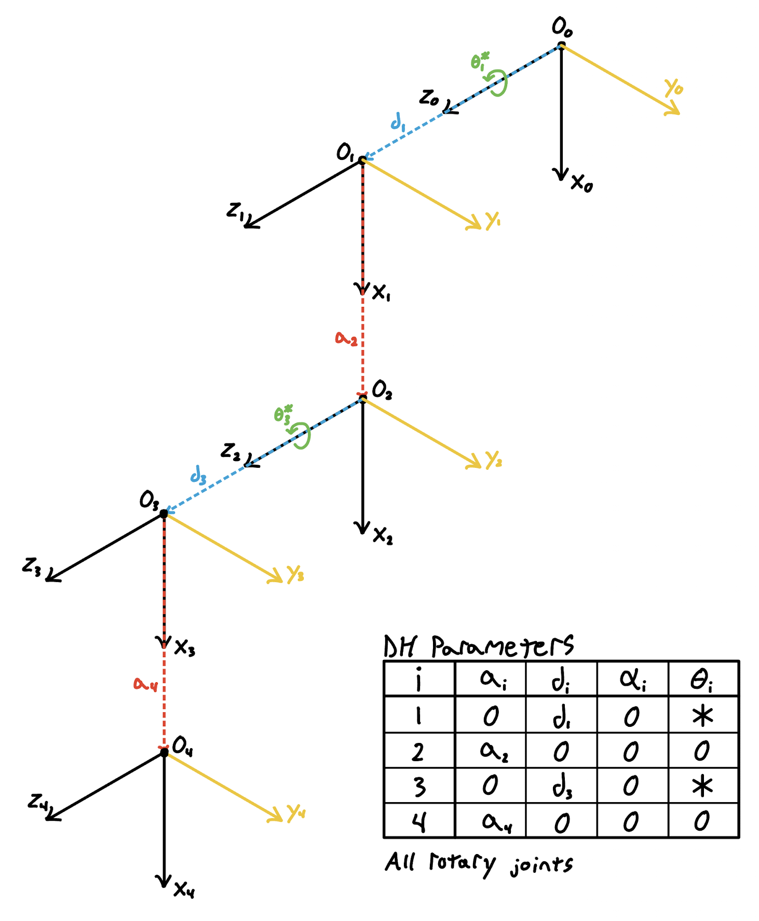
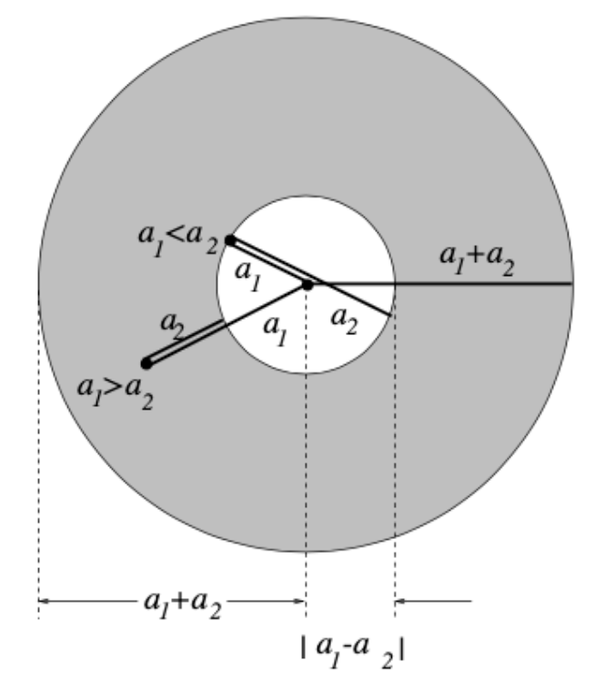
Engineering Design - Drawings and CAD
Based on ODRI 8-DoF base with reinforced legs, carrying handle & larger bed to place components

Slide 13
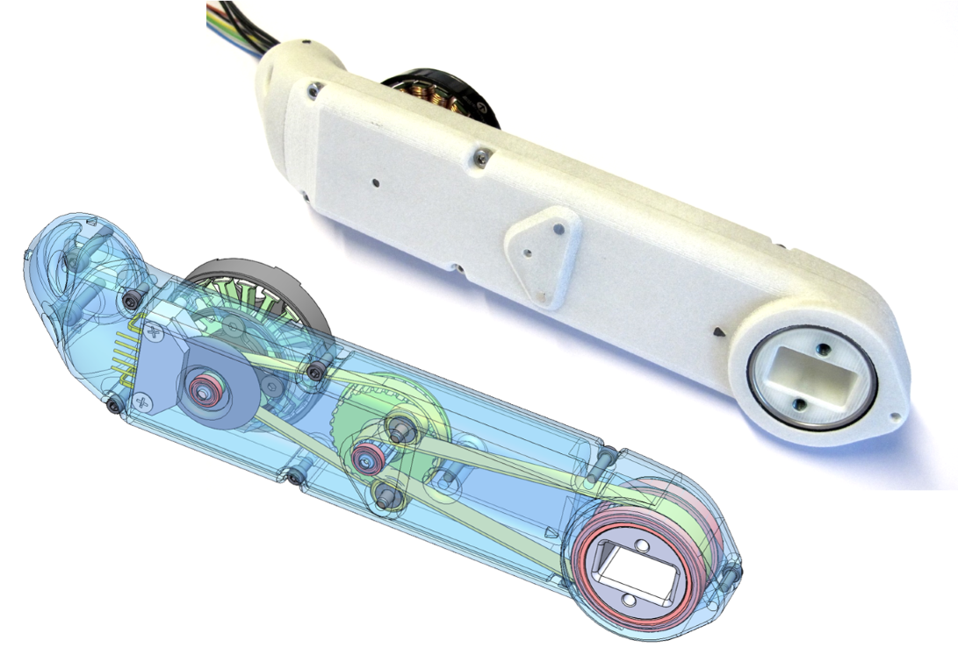
Engineering Design - Actuator Modules
Built from ODRI Project
Initial constraint: don’t deviate from design
9:1 gear ratio
Custom made encoders
5000 DPS Quadrature Optical Encoders
~150g at a rated 2.7 N-m at 12A
STL provided on ODRI repository
Design iterated on by the team to reinforce legs and easy replacement

Slide 14
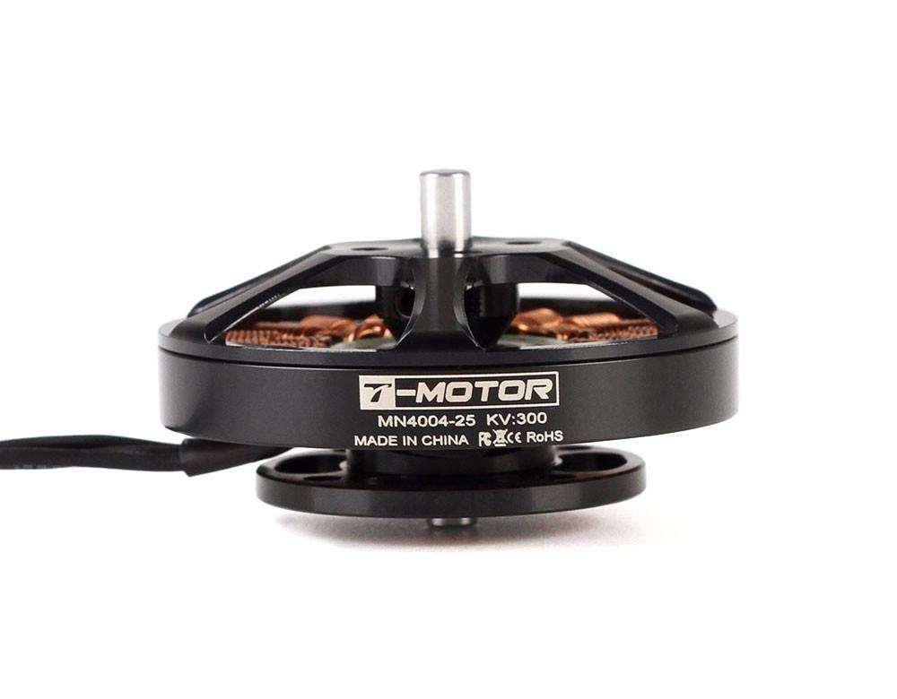
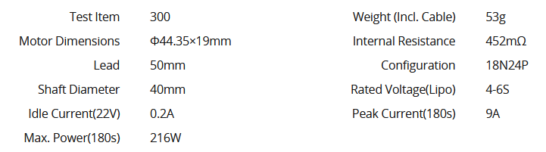
Engineering Design - Motors
MN4004 Antigravity Type 4-6S UAV Motor KV300
Brushless motors recommended by ODRI Project
Made for compatibility with encoder modules
Lightweight + high power rating

Slide 15
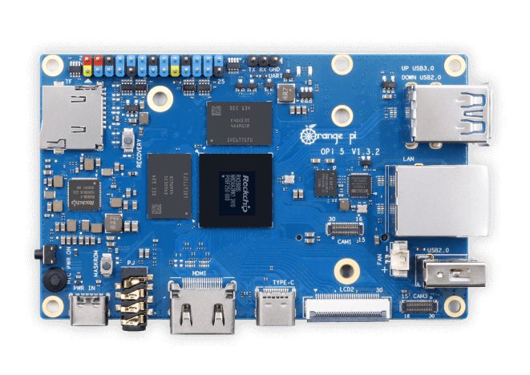
Engineering Design - Orange Pi 5
Desired mini computer choice by sponsors
Lightweight, small form factor
2.4 GHz communication rate
M.2, USB + C, CAN, I2C, UART, SPI
PWM and Interrupt Support
20 W Power Draw (5V, 4A)
In-depth Linux support
Ubuntu support, ROS2 Humble Hawkbill has great support on Ubuntu LTS 22.04

Slide 16
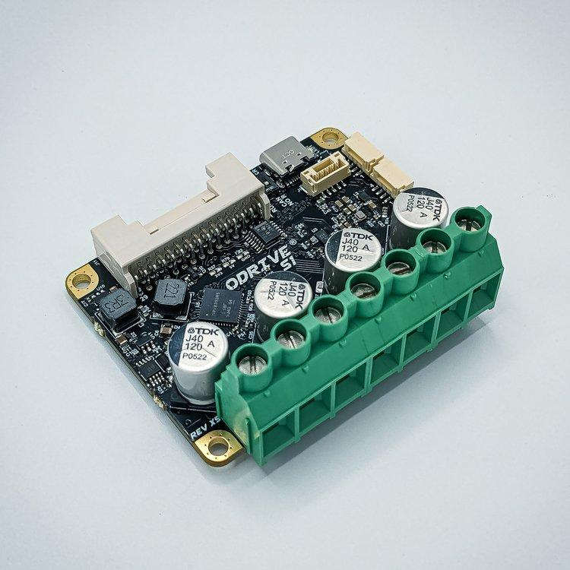
Engineering Design - ODrive S1
Brushless Motor Controller Board
Chosen for brushless motor servo control
Found based off acquired motors
Extensive support, code libraries for ROS2, daisy chain CAN support, active stack exchange forums
Effective replacement for custom driver boards outlined in ODRI

Slide 17
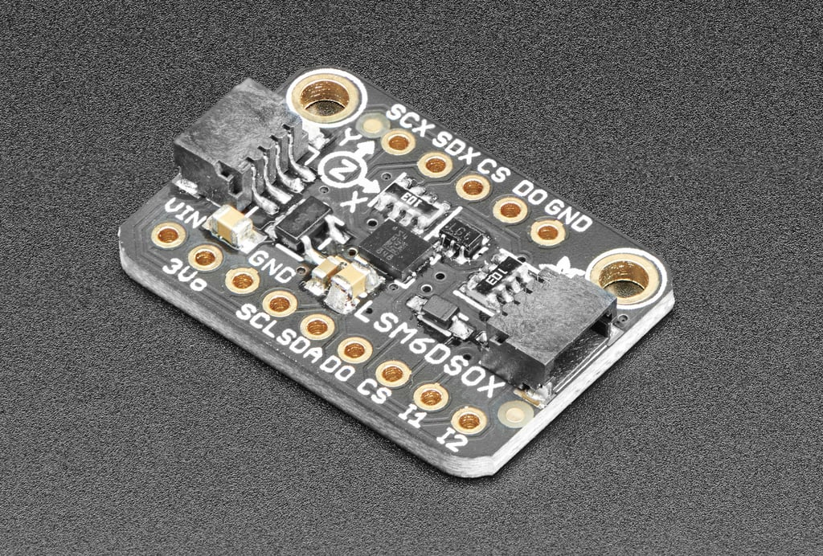
Engineering Design - Adafruit ISM330DHCX
6 Degree-of-Freedom accelerometer and gyroscope
Matches specifications of ODRI project
Accelerometer to determine direction of gravity
Gyroscope to determine rotational speed and position
Pi/Python computer compatible
Allows implementation into ROS2 as a python node

Slide 18
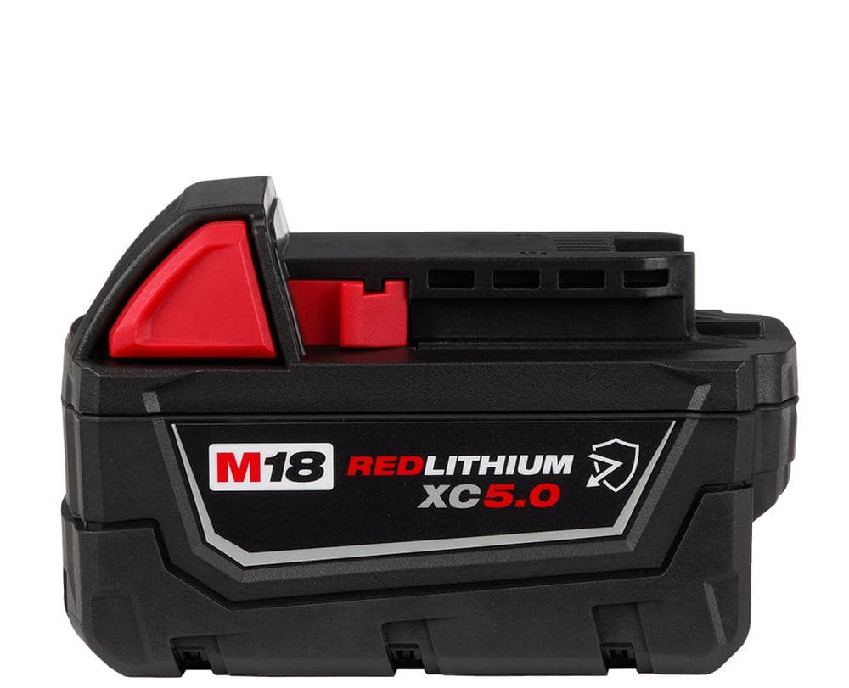
Engineering Design - Power System
2x Milwaukee 18V 5Ah Batteries
Built-in power control and safety capabilities
High current limit
1.5 lbs per battery
Will need to adapt design to balance robot operation time with weight (More capacity = more weight)
Expected power draw: <200W
Meets 0.5-1 hour runtime requirement (180Wh)
2x
8x
8x

Slide 19
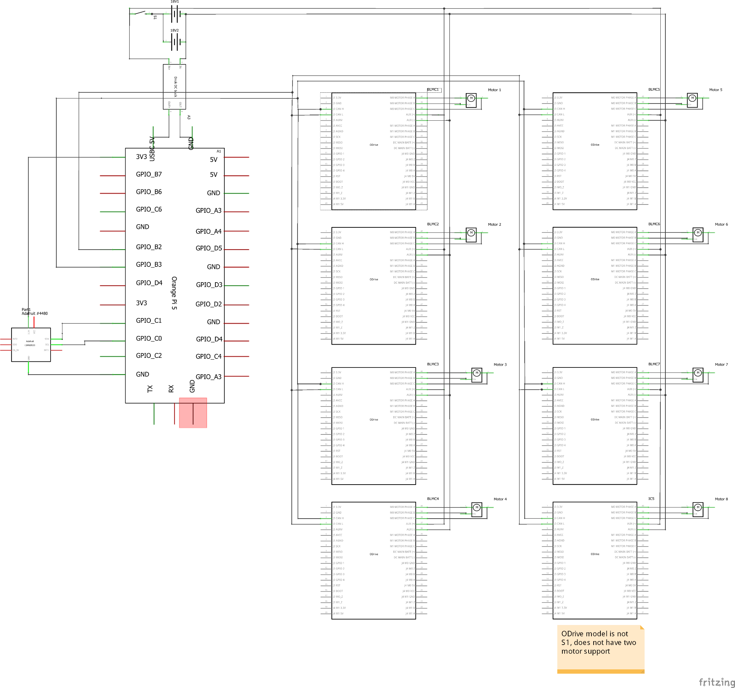
Engineering Design - Electronics Diagram
ODrive BLMCs are daisy-chained together for CAN communication

Slide 20
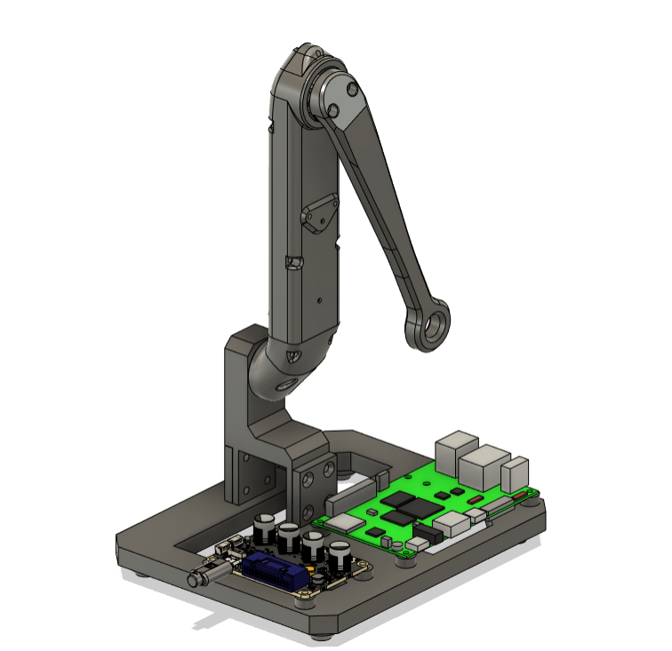
Proof-of-Concept Test
The critical robot function is the ability to accurately execute positional control of eight actuators according to commands
This requires:
The angular accuracy/resolution is sufficient
Power is sufficient for desired runtime
IMU response is fast enough
The actuators supply enough torque
The CPU is fast enough
CAN bus can support the data transfer rate
Figure: Test stand CAD model

Slide 21
Proof-of-Concept Test
Design Specification | Test Specification | Success
Response Accuracy | Position Control Resolution (step size) | <3°
Runtime | Power Draw (single motor) | <200 W
Response Speed | Delay between IMU motion and motor motion | <200 ms
Response Speed | CPU Load (single motor) | <12%
Response Speed | Total data transfer rate on CAN bus (single motor) | <1000 kbps
Strength | Stall torque (at end of gearing) | >1.83 Nm

Slide 22
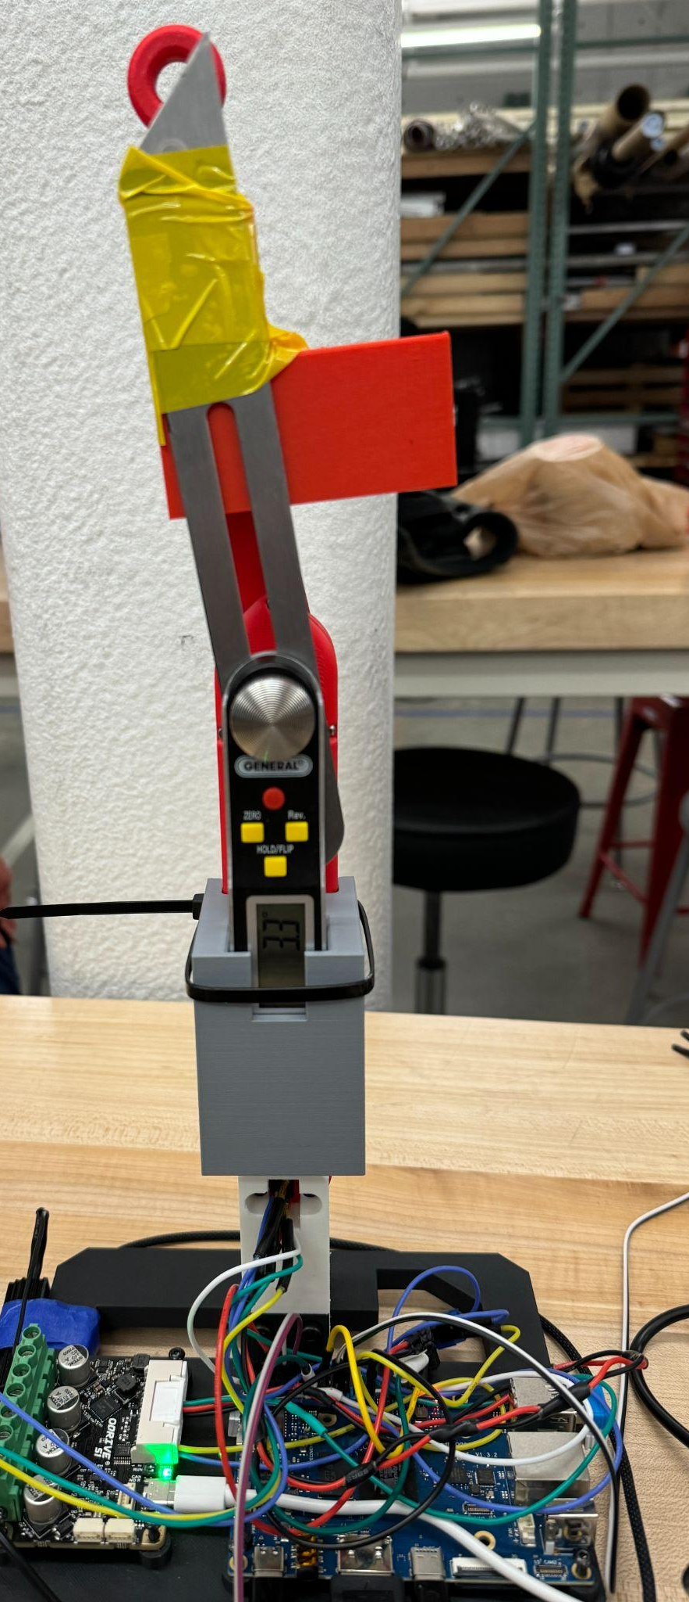
Proof-Of-Concept Test Results
Angular Resolution
Method
Angular protractor is mounted to the test leg
Manual positional step commanded
Change in angle measured
Determines the detail of terrain we can adjust to
Result
Minimum angular step size = 0.05°
Figure: Test Stand Configuration

Slide 23
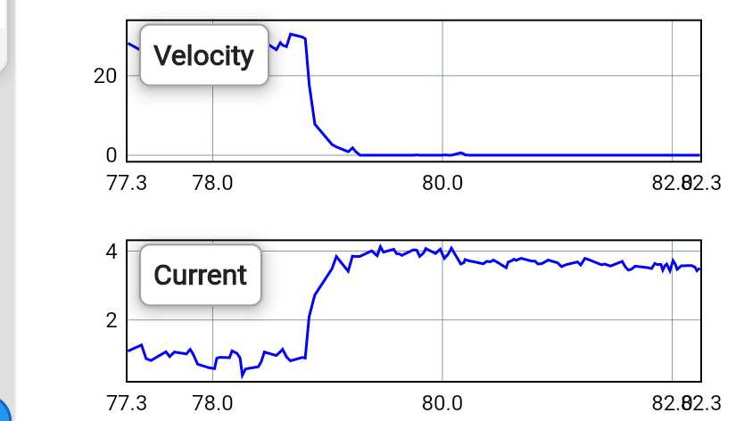
Proof-Of-Concept Test Results
Power Draw
Method
25% of the weight of the final robot attached to leg
Leg commanded back and forth to approximate power draw while walking
Current can be measured by the O-Drive motor driver GUI, Voltage held constant at 20V by power supply
Calculate to power draw via V*I = P
Determines battery requirements
Result
Average Power Draw = 54 W
Peak Power Draw = 80 W
Figure: O-Drive GUI

Slide 24
Proof-Of-Concept Test Results
IMU Response Time (testing still in progress)
Method
Film the test stand in slow motion
Tilt the test stand
Measure the time it take the motor to reach position after IMU input
Result
Approximate Response Time = TBD
Video: Test leg response

Slide 25
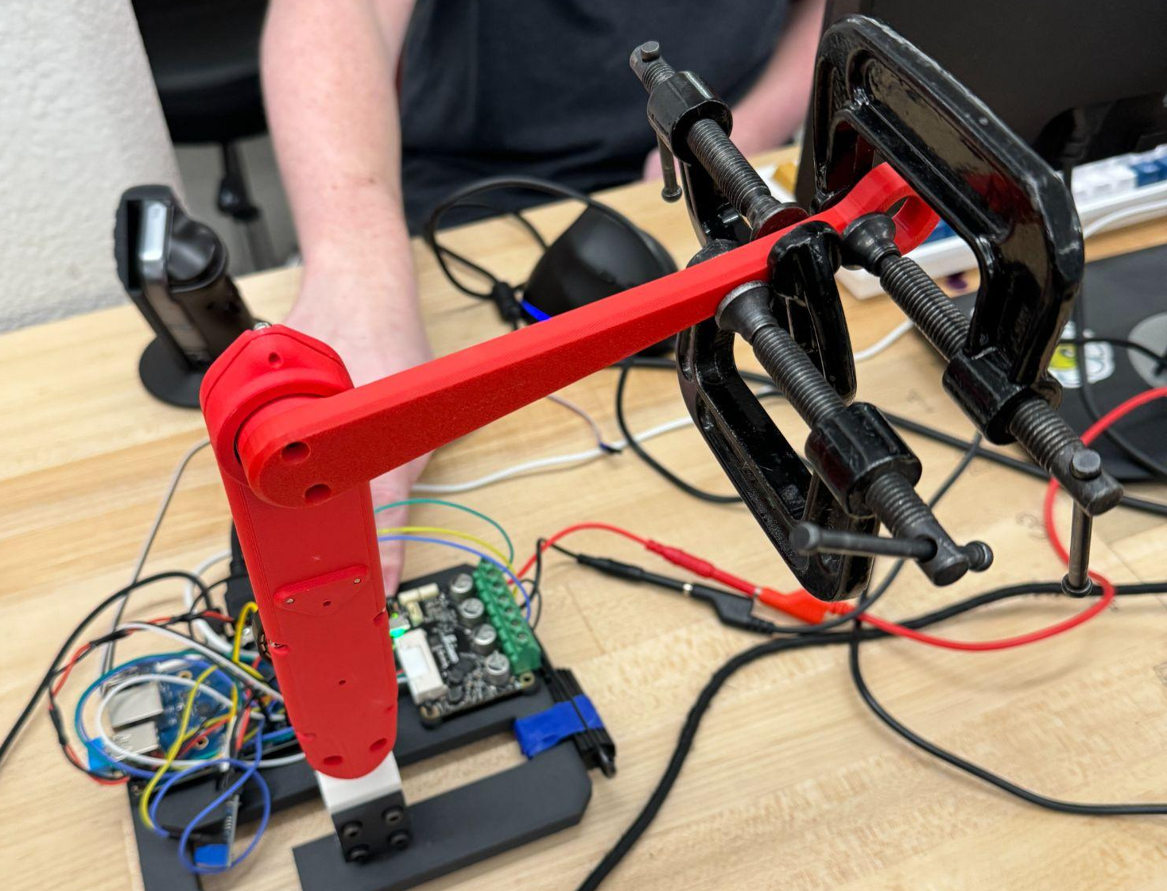
Proof-Of-Concept Test Results
Stall Torque
Method
Attach weights (165g clamps) to the end of the leg
Calculate applied torque via T = m*g*r
Continue until actuator can no longer lift the weight
Must be greater than peak torque due to one quarter of robot’s weight
Determines load capacity
Result
Stall Torque = 0.714 Nm @ 5 A
Stall Torque (extrapolated) = 2.142 Nm @ 15 A (max)
Figure: Weighted test stand assembly

Slide 26
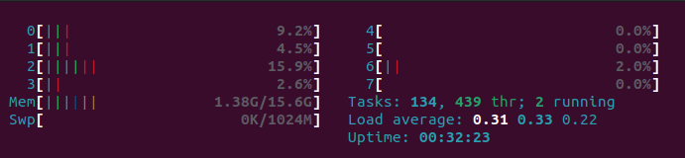
Proof-Of-Concept Test Results
CPU Usage
Figure: Linux terminal output
Method
Run Python leg movement script
Display CPU usage via Linux terminal
This must be less than 1/8th of the capacity of the CPU
Result
Across all cores,
Single Motor CPU Usage = 4.2%
Memory Usage = 1.38 Gb

Slide 27
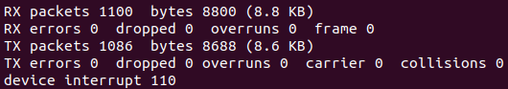
Proof-Of-Concept Test Results
Data Transfer Rate (CAN bus)
Figure: Linux terminal output
Method
Run ifconfig -a to determine total can transfer value
Spin leg via CAN bus for 10 seconds
Run ifconfig -a again. Difference/10 seconds = Transfer Rate
Must be less than an eighth of the CAN bus capacity
Result
Data Transfer Rate = 0.25 kbps

Slide 28
Proof-of-Concept Test Conclusions
Design Specification | Test Specification | Test Results | Success
Response Accuracy | Position Control Resolution (Step Size) | 0.05° | <3°
Runtime | Power Draw (single motor) | 80 W | <200 W
Response Speed | Delay between IMU motion and motor motion | TBD | <200 ms
Response Speed | CPU Load (single motor) | 4.2% | <12%
Response Speed | Total data transfer rate on CAN bus (single motor) | 0.25 kbps | <1000 kbps
Strength | Stall torque (at end of gearing) | 2.14 Nm | >1.83 Nm

Slide 29
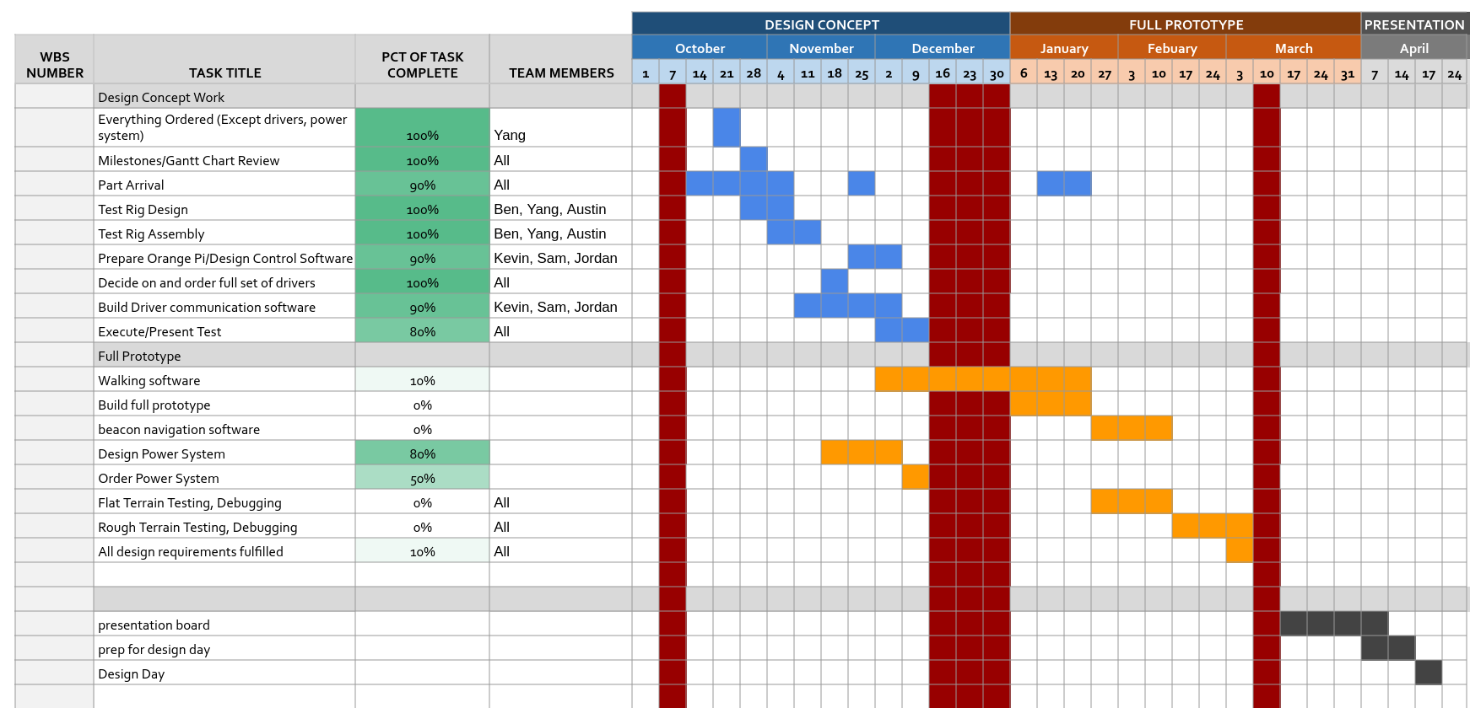
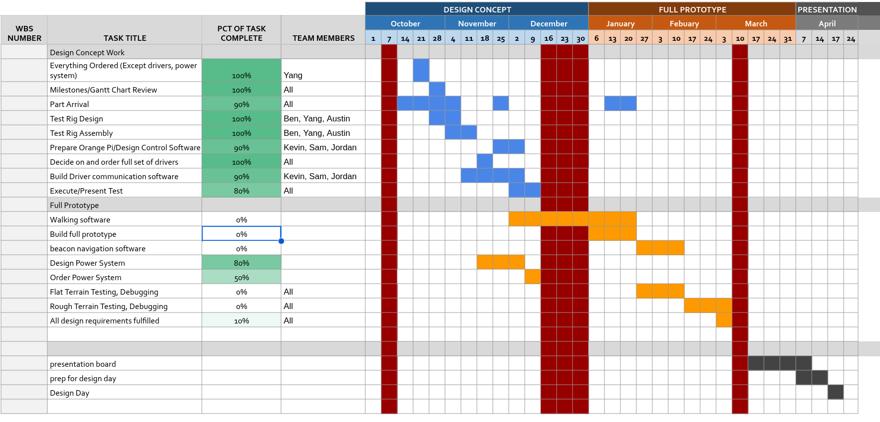
Project Management - Plans

Slide 30
Ordering Totals:
Total Ordering Information from Purchasing Request Site
Vendor | Date | Subtotal
PWB Encoders | 9/21 | $1,245.77
Amazon | 9/28 | $134.74
Amazon | 9/30 | $9.99
123 Bearing | 9/30 | $382.61
Belting Online | 9/30 | $202.61
McMaster-Carr | 9/30 | $76.10
Amazon | 9/30 | $7.99
Digikey | 9/30 | $14.49
Amazon | 10/10 | $127.99
ODrive | 10/21 | $156.61
Bambu Lab | 10/21 | $69.98
Adafruit | 10/21 | $21.33
Digikey | 10/21 | $93.15
Amazon | 10/21 | $119.80
Amazon | 11/11 | $19.98
ODrive | 11/11 | 1,050.61
Amazon | 12/3 | $311.55
As of 12/3 | Total (+tax&ship): | $4,045.30
Total Budget Available: $6000
Remaining: $1954.70
Projected Usage:
$300 for sensors
$500 for backup parts

Slide 31
Questions?

